Slide 1
IMPLEMENTATION OF OPTIMIZED PIXEL-PROJECTED REFLECTIONS FOR PLANAR REFLECTORS
Byumjin Kim
Computer Graphics and Game Technology
University of Pennsylvania
Notes:
Hello, my name is Byumjin Kim. Thank you for participating in my master's thesis presentation. Today, I’m gonna talk about the idea what I was inspired from. And, how I improved it and implemented this with Vulkan API.

Slide 2
Overview
Motivation
Previous work
Ray tracing
Ray Marching
Screen Space Reflections
Implementation
Main topic
Pixel-projected Screen Space Reflections
Improvement
Results
Limitations
Conclusion and Future work
Notes:
This is the overview of my presentation. It will proceed in the same order as my thesis.
Ok,. let's start it!

Slide 3
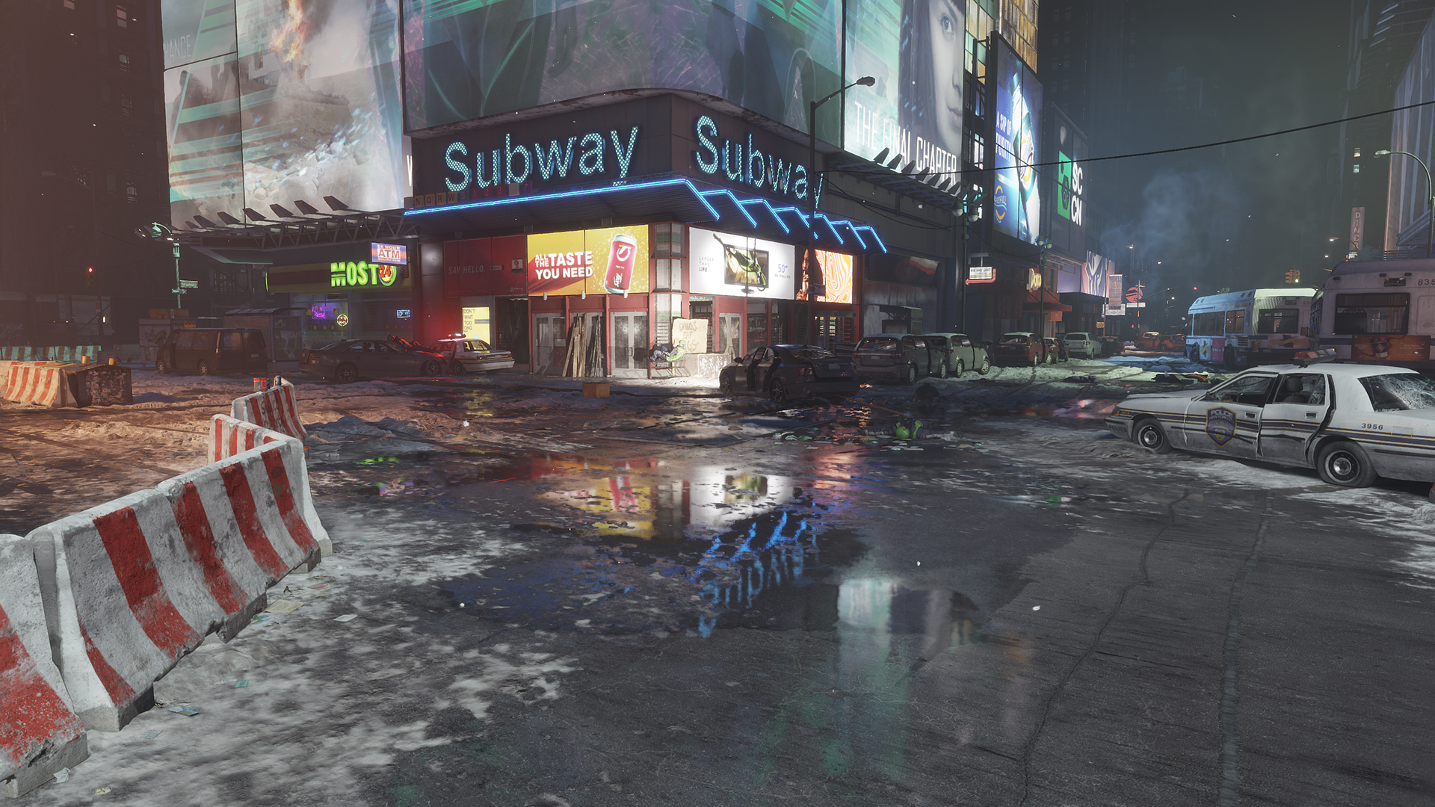
Motivation
Notes:
I’m always interested in real-time graphics technologies for video games, especially in dynamic global illumination. But, as you know, getting a dynamic global illumination in a real-time environment is a difficult issue.
Especially, to obtain dynamic reflections, many screen-space reflections techniques using ray marching have been studied, but they are expensive to use for real-time rendering.

Slide 4
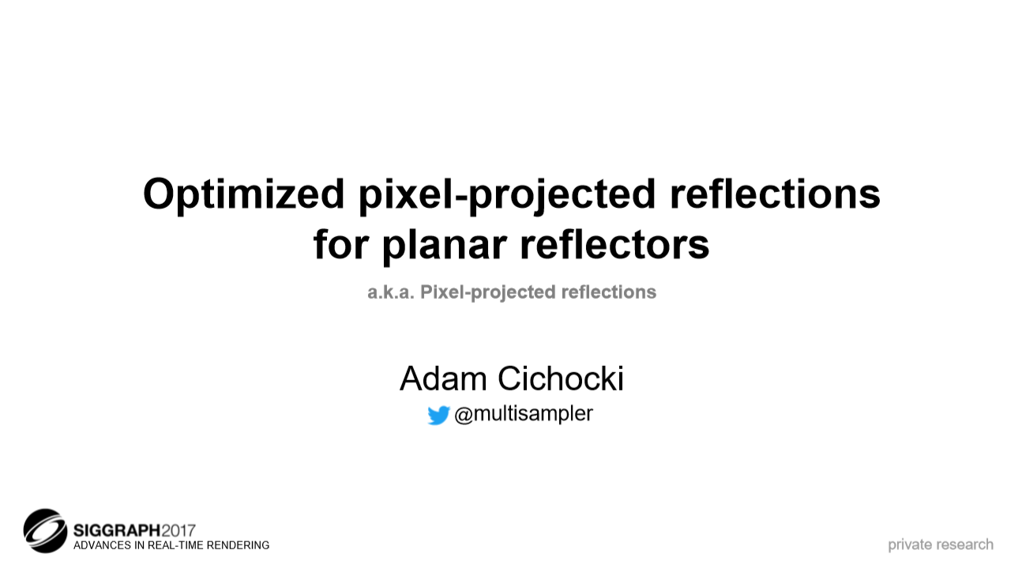

Motivation
Notes:
In SIGGRAPH 2017, there was an announcement that caught my attention. It was called pixel-projected screen space reflections.
And, unlike traditional approaches using ray marching, it was about using ray tracing for screen space reflections.
After I scheme the idea, (click) I wanted to know about the trials and errors when I implement it using Vulkan whit GLSL instead of using DirectX with HLSL as the original paper.
And, I also wanted to find out if there was any way to improve it.

Slide 5
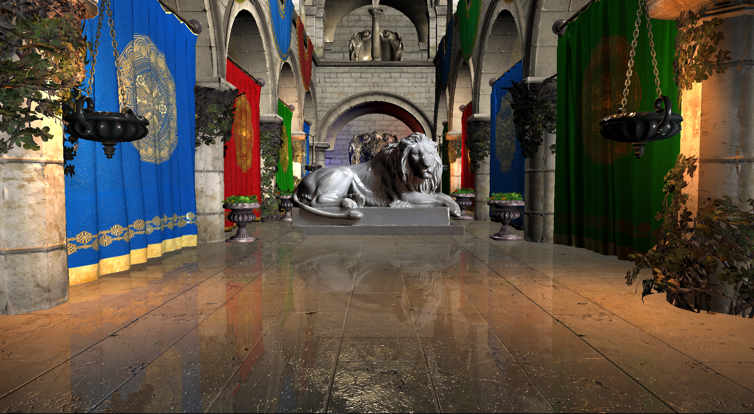
Optimized pixel-projected reflections for planar reflectors
(0.779 ms on a GTX1060 in full HD resolution 1920 x 1080
Notes:
This is the result scene of my application. I used one reflector which covers whole floor for this.
As you see, it just takes under 0.8 ms on full hd resolution.

Slide 6
Previous Work
Ray tracing
Ray marching
Screen Space Reflections
Notes:
Before going into the main approach, I’m going to describe previous works ray marching, which is the basic algorithm of screen space reflection, ray tracing, which is the original technique of ray marching, and then explain what screen space reflection methods have been studied, so far.

Slide 7
Previous Work – Ray tracing
Intersection point of 1st ray
camera
1st ray
2nd ray
screen space
Notes:
Ray tracing is a rendering technique that traces the ray's path from the pixels in the imaginary screen space image plane to produce the result image. This technique is mainly used to generate a high degree of visual realism, but it also requires a high cost. The first ray tracing algorithm used for rendering was presented by Arthur Appel in 1968.
The algorithm is, (click) If an object is found, a reflection vector (click) can be calculated using the surface normal vector at the intersection, which can then be traced to find reflected color. (click) This can continue for an arbitrary number of light bounces.

Slide 8
Previous Work – Ray tracing
Shadow feeler
camera
Light source
screen space
Notes:
And, it is also possible to get shadow factor. To compute the shadow, at the point where the pixel in screen space, (click) shoot a ray, which is called shadow feeler, again to the light source and check for its visibility. This will result in a hard shadow, but using multiple samples will result in a soft shadow based on the averaged result.

Slide 9
Previous Work – Ray marching
camera
Tracing points
Marching Ray
Notes:
Ray marching is a technique similar to ray tracing. To find the surface point, many points along the ray must be tested.
First, from the reflective surface, (click) march along the reflected ray, and project each march point to screen space and compare its depth with depth buffer. If the depth is larger than depth buffer, we judge that the ray intersected the object represented at that part of the depth buffer.
Step size is the most important factor, and is difficult to calibrate: if the size is too small, finding the intersection is too slow, but if it is too large, it becomes possible to overshoot the true point of intersection on the surface. However, the reason why ray marching is useful for reflection is that ray tracing is too expensive in real-time scenes without adequate acceleration structures. For this reason, previous methods of screen space reflections have evolved based on ray marching.

Slide 10
Previous Work – Screen Space Reflections
Brute Force Screen Space Reflections
Hi-Z Screen Space Reflections
Tile Classification
Notes:
Now, let's see what screen space reflections approaches were used for real-time rendering, so far. The methods on the screen are based on the idea of using the ray marching to obtain the color information by ray marching against the screen’s depth buffer.

Slide 11
Previous Work – Brute Force Screen Space Reflections
camera
Depth buffer
Tracing points
Pixels in screen space
Notes:
Brute force is the most basic method for screen space reflections. First, (click) calculate the reflection vector using the normal and view vectors in the screen space for each pixel. Next, (click) advance the tracing point by a certain step size along the direction of the reflection vector. Each time the tracing point moves forward, compare depth value obtained by projecting the current tracing point into the screen space with depth buffer.
If the depth value of the tracing point is larger than the depth buffer, stop ray marching and obtain the scene image pixel value of the current point.

Slide 12
Previous Work – Improved Brute Force SSR [Val14]
1
1/4
¼ Downsampling
Notes:
As I mentioned earlier, Using a small step size gives the best screen space reflections quality, but it is hard to maintain 60 fps in real time due to the current hardware performance. To solve this, Killzone : shadow fall made by Gurilla games. used a downsampled frame buffer at 1/4 resolution to reduce instructions executed per pixel.

Slide 13

Previous Work – Improved Brute Force SSR [Val14]
$\left(a\right)x\left(\frac{\left(d\right)−(b)}{\left(a\right)−\left(b\right)−(\left(c\right)−(d))}\right)$+$(b)$
(c)
(a)
camera
(b)
(d)
Pixels in screen space
Notes:
Also, to use a larger step size with fewer artifacts, (click) they used simple linear interpolation between a hit point and the previous point with depth buffer values of the points.

Slide 14
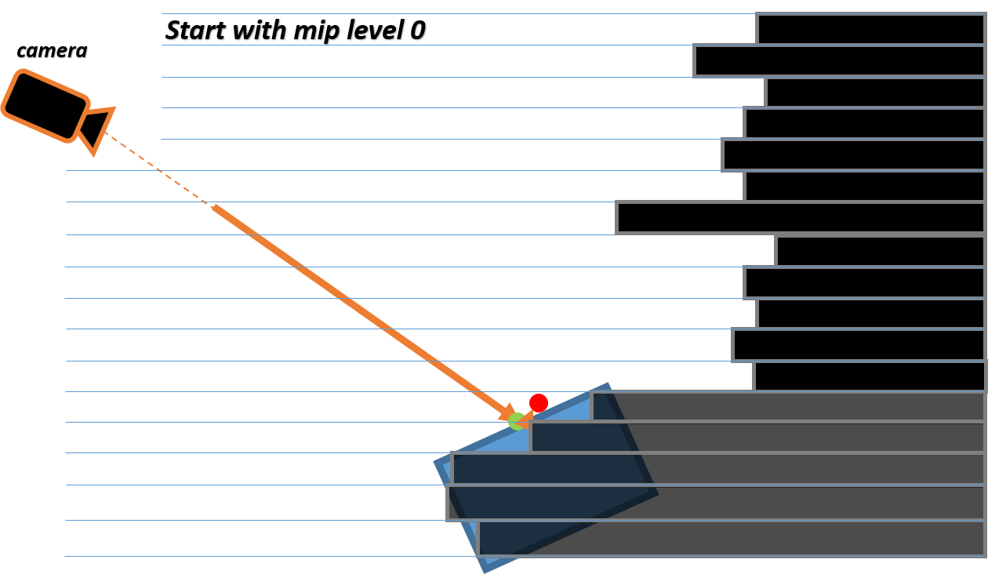
Previous Work – Hi-Z Screen Space Reflections [Uludag14]
Notes:
[Uludag14] devised pixel-based ray marching using a hierarchical depth buffer, also known as the Hi-Z buffer. The Hi-Z buffer creates a hierarchical structure by using a downsampling process that compresses the information of four neighboring pixels into one pixel.
In the case of downsampling the depth buffer, the minimum value among the pixels filtered together should be used to prevent the ray from missing the closest intersection.

Slide 15
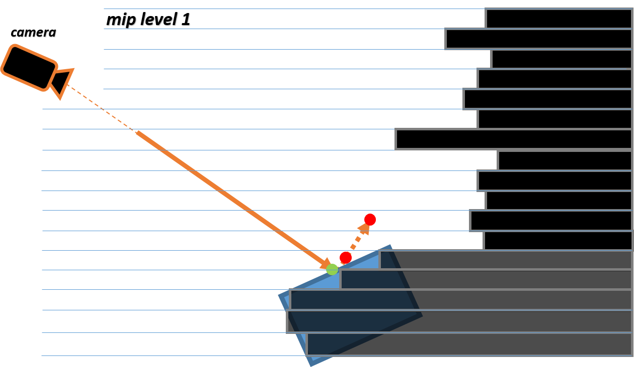
Notes:
After generating the Hi-Z buffer, ray marching starts on the first mip level.

Slide 16
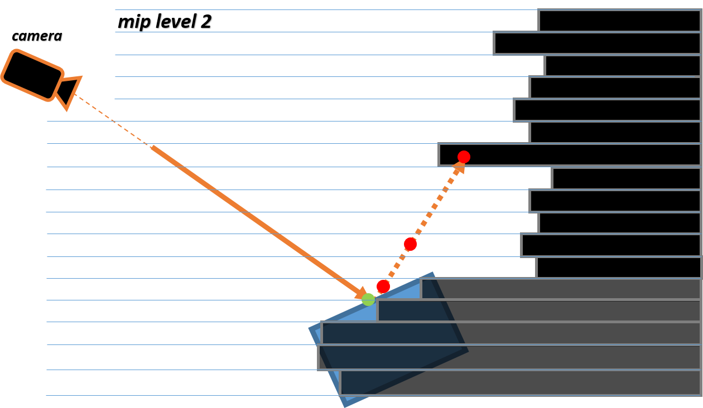
Notes:
If there is no intersection, then increase the mip level try again at the target point.
And, If the target point hit an object

Slide 17
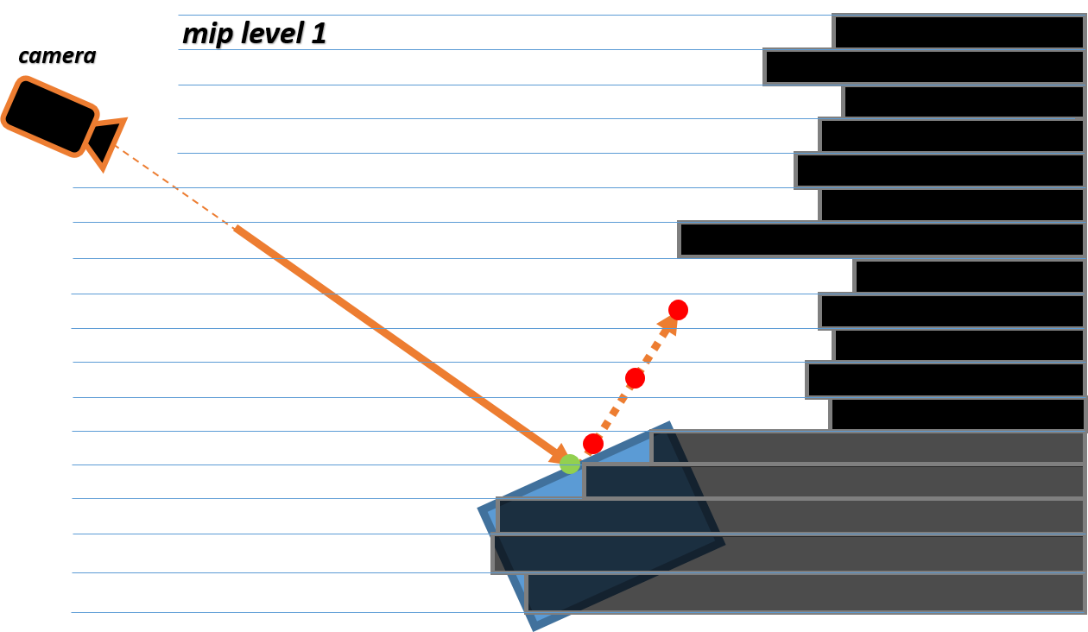
Notes:
decrease the mip level

Slide 18
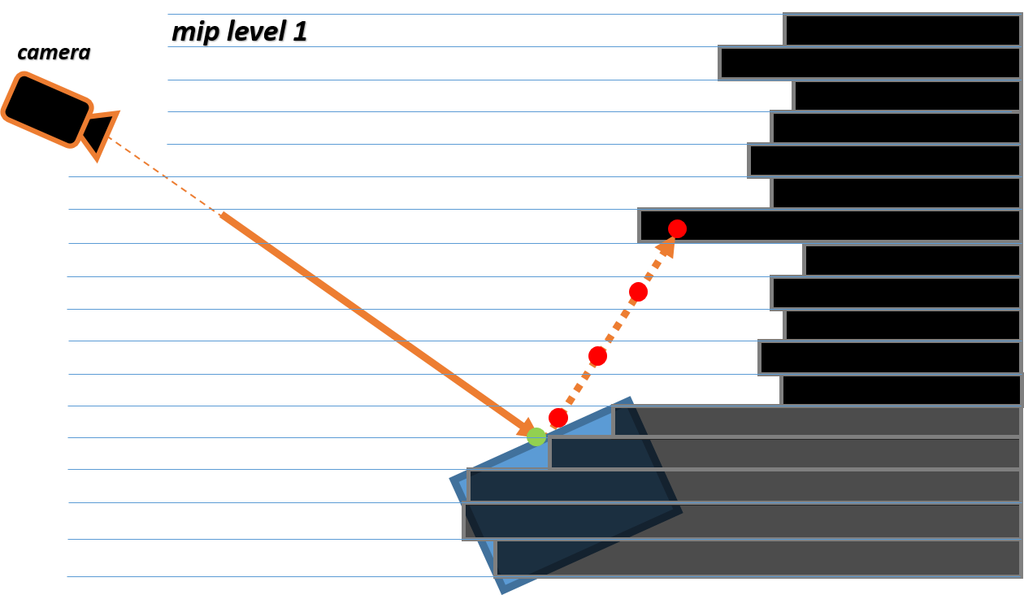
Notes:
and do ray marching again at previous target point's position.

Slide 19
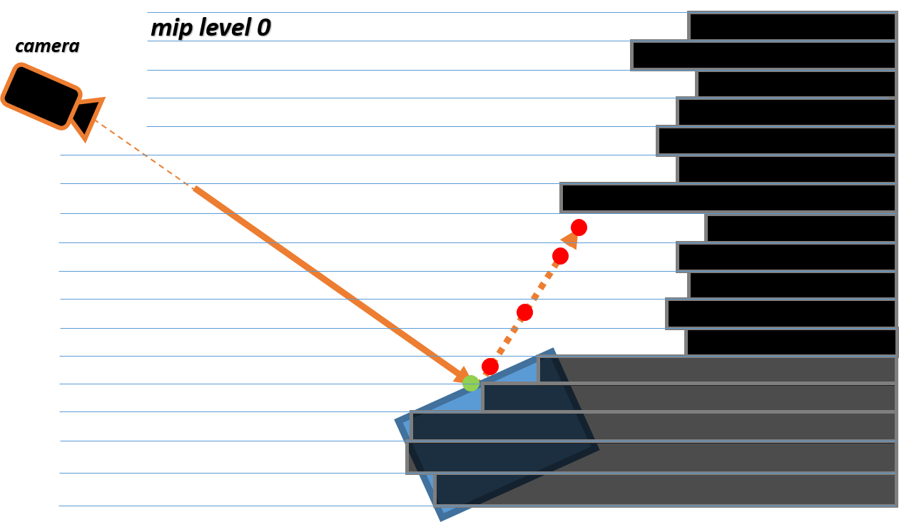
Notes:
So, repeat these steps until the target point hits an object against minimum level of Hi-Z buffer

Slide 20

Notes:
In this way, we can prevent a ray from passing through tiny objects. However, it costs extra to create a depth buffer hierarchy for every frame.

Slide 21

Previous Work – Tile Classification
Tiles in screen space
This image is the result of screen space reflections, not the scene image.
(b)
(a)
Notes:
For most scenes, a vast majority of pixels in screen space do not contribute to the final reflection result. With this idea, we can discard non-contributing pixels.
Like, after divide the screen into square tiles, create some small number of test rays for each tile, which uses non-uniform jittered samples to prevent artifacts caused by using uniform sampling. If none of the test rays hit, like (b) in the image on the screen, we can discard the non-contributing tile for saving cost. Otherwise, march on each pixel in the tile.

Slide 22
Implementation
Multi-Threading
Memory management
Notes:
So far, we've looked at previous screen space approaches.
Now, for talking about more practical things, I'm going to explain my application structure.
The original idea of pixel-projected screen space is implemented with hlsl for DirectX.
But, I wondered about the trial and errors that came with the implementation with Vulkan.
(click) Then, what is the Vulkan and what makes Vulkan be attractive?
Vulkan is a modern graphics API designed by the Khronos Group. It is an explicit API for the graphics hardware and keeps the drivers work to the minimal. Because of this, Vulkan provides high flexibility for programmers to optimize.
(click) One of the big advantages of using Vulkan is multi-threading. Since every Vulkan command is recorded before it is executed, We can execute multiple commands, simultaneously.
(click) Another big advantage of using Vulkan is the flexibility of controlling resource memory. Like, Instead of directly mapping memory from the host, we can use a temporary buffer for staging and transferring the data from client memory onto device memory.

Slide 23
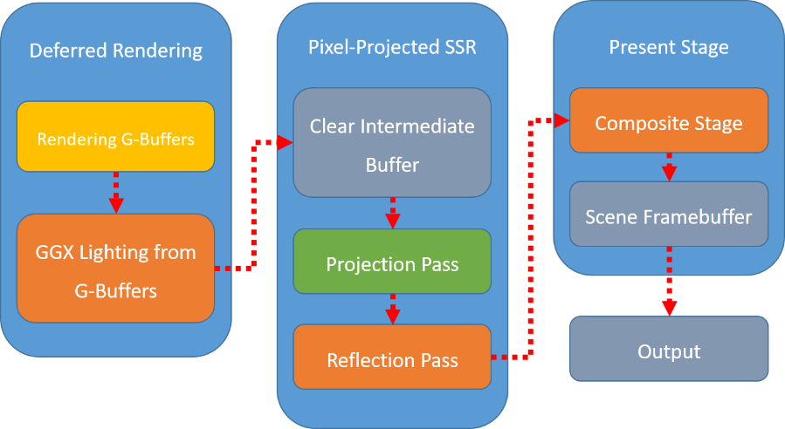
Implementation – Pipeline
Fragment Shader
CPU Side
Compute Shader
Notes:
With Vulkan API, my application uses deferred rendering because it is natural to get and reuse normal data in screen space for screen space reflections. I used 3 G-buffers (first one is for albedo and opacity, second one is for specular color and roughness, third one is for normal and metallic). For screen space rendering stages, the application uses a single triangle to fill whole screen instead of the traditional quad, which consists of two triangles, for better performance. It also uses multiples vertex / fragment shaders and one compute shader. After calculation of the screen space reflections, the original scene image and the result are combined and print to the monitor.

Slide 24
Main topic
Pixel-projected Screen Space Reflections
Improvement
Notes:
Ok, now, this chapter is for the main algorithm of this thesis.
I’m gonna describe the original idea first with trials and errors from implementation.
Then, I will explain my idea to adjust this approach with physically-based rendering environment.

Slide 25
Pixel-projected SSR – algorithm overview
Projection Pass
Set rectangle shape reflectors.
For every pixel, find the reflectors that reflect it.
Project pixels on those reflectors.
Encode pixel-data and write to Intermediate buffer.
Reflection Pass
Read pixel-data from Intermediate buffer.
Decode pixel-data and obtain reflected color
Write color to reflection buffer
Notes:
Pixel-projected Screen space reflections has two steps. (click) First, in the “Projection pass”, for every pixel in screen space, find the reflectors which reflect the pixel. (click) Next, the “Reflection pass”, simply decodes pixel-data and obtains the reflected color from data, which is called Intermediate buffer, from Projection Pass.

Slide 26

Pixel-projected SSR – Previous stage
Intermediate Buffer
Notes:
Then, what is the Intermediate Buffer?
We know that, to transfer information between shaders per pixel, we need to use a read/writeable buffer which has the same number of elements as the number of pixels in the current screen.
So, That is the intermediate Buffer. And, after creating the buffer, we need to clear it before entering the Projection pass.

Slide 27
Pixel-projected SSR – Projection Pass
Notes:
Now, with cleared intermediate buffer, Projection pass get started. For simplicity, let's first look at the case where there is only one object and one reflector. First, every pixel in screen space calculates where it is reflected on the screen. To do this, (click) mirror pixel position against normal of reflector and (click) ray-cast toward the mirrored pixel position. Yes, this is really simple.

Slide 28
Pixel-projected SSR – Projection Pass
Notes:
If we can just write the reflected color to Intermediate buffer in Projection pass and fetch it in Reflection pass, it would be the best situation. But, the problem is (click) multiple pixels can be written to the same place. That means we need to write the closest pixel to be reflected, only. But, we are processing pixels, independently. And writing order between the threads of a shader depends on GPU scheduling.

Slide 29
Pixel-projected SSR – Projection Pass
uint atomicMin()
Y
X
X
Y
X
Y
X
Y
(0)
(1)
(2)
(3)
Notes:
To address the issues, we need to pack each offset data on the screen space between the reflected pixel and the reflecting pixel to one 32bit data.
Because, we can solve the order issue with using (click) atomic function (atomicMin function in this case).
Then, how do we pack the offset data?
For writing the closet reflected pixel, we need to set certain offset coordinates system, which is 2-Dimention, to compare which offset is the closest among the pixels written to the same place.
(click) From studies, it is enough to use 4 offset coordinate systems like this.

Slide 30
Pixel-projected SSR – Projection Pass
Y
X
X
Y
X
Y
X
Y
abs(y)
(0)
(1)
(2)
(3)
X
abs(x)
Y
abs(x) > abs(y)
Notes:
More specifically, we need to find the longest axis among x and y-axis with its orientation positive or negative.
Then, make the longest axis become y-axis.
Lastly, depending on the new y-axis’ orientation, x-axis’ direction is determined.
(click) For example, if the longest axis of offset data is x-axis and its orientation is negative like the image on the screen, (click) the coordinate system is number 3 .

Slide 31
Pixel-projected SSR – Projection Pass
Screen width
Screen height
2 bits coordinate system index
(0 … 3)
12 bits ‘Y’ integer
(unsigned)
12 bits ‘X’ integer
(signed)
3 bits ‘Y’ fraction
(signed, flipped)
3 bits ‘X’ fraction
(signed, not flipped)
Notes:
Now, from these new coordinate systems, ‘y’ coordinate is always positive. So, if we encode ‘y’ coordinate to most significant bits in one element of the Intermediate buffer, it can write the shortest, in another word “the closet”, pixel to the buffer with using atomicMin function.

Slide 32
Pixel-projected SSR – Projection Pass
SSBO
Or
Storage Image ?
Ex) 1920 x 1080 = 2,073,600
Notes:
But, unlike HLSL in DirectX, GLSL in OpenGL or Vulkan does not support float type atomic.
So, we need to use uint atomicMin function for storing 32-bit unsigned int instead.
At this moment, we have two options. we can use the Intermediate buffer type as a shader storage buffer object, which is called SSBO or a storage image. But, with SSBO, the cost will increase significantly as the buffer size increases. This is because the array retrieving time increases as the index of the array element increases.
For example, (click) if we are using full HD resolution SSBO has 2,073,600 array length. So, it makes tremendously slow.
This is the same principle when we try to implement GPU particle system like the method using texture for storing tremendous of particles’ information faster than the method using vertex transformation.
Therefore, (click)I used a 32-bit unsigned storage image buffer with uint imageAtomicMin function.

Slide 33
Pixel-projected SSR – Reflection Pass
Read the Intermediate buffer
Decode the data to retrieve the offsets
Obtain reflected color from the scene image
Notes:
Now, we are in Reflection pass and this stage is simple. For each pixel, read the Intermediate buffer and decode the data to retrieve the offsets. Then, obtain reflected color from the scene image.

Slide 34
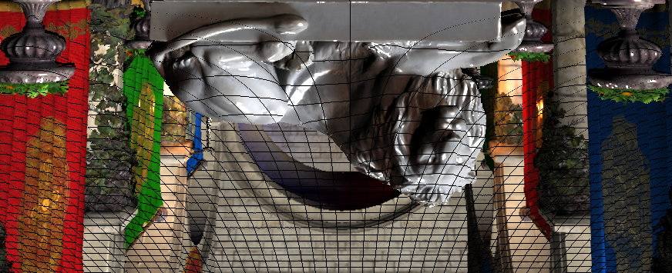
Pixel-projected SSR – Reflection Pass
Need holes patching
Notes:
However, the result will have a lot of holes. Because, the original scene image can get stretched when reflected.
So, Intermediate buffer can get two types of missing data called holes in here.

Slide 35
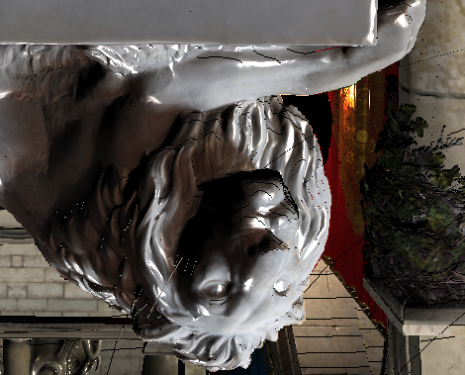
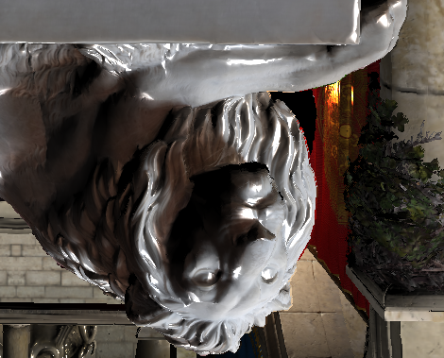
Pixel-projected SSR – Reflection Pass
Notes:
There are two types of holes. (click) First one is the hole without any data. (click) Second one is the hole which could not get data from first reflection layer. Fortunately, these holes do not form big groups. So, we can fill the holes like comparing neighboring pixels’ offset and use the one which has the minimum offset among them.

Slide 36
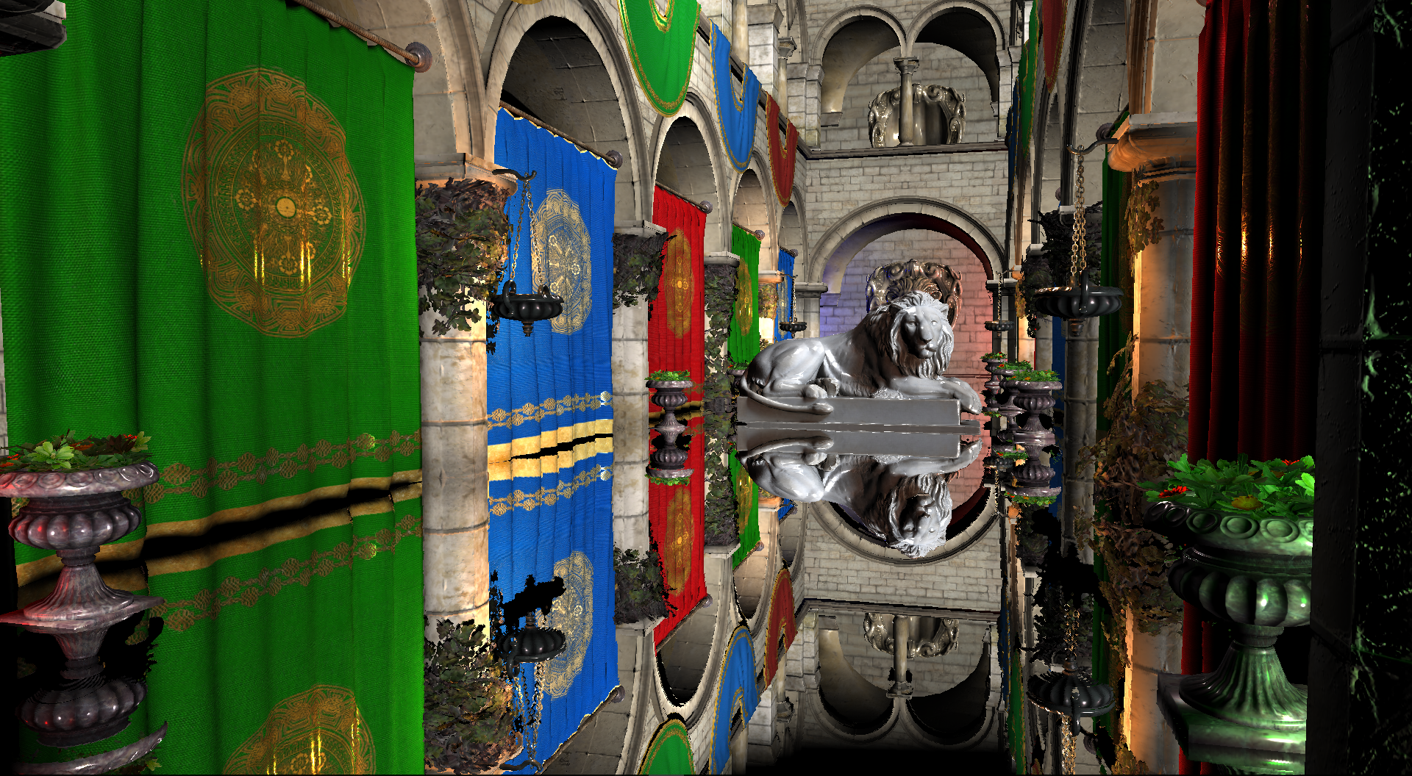
Pixel-projected SSR – Apply normal map
Notes:
So far, we've covered all the process of pixel-project screen space reflections. And this is the result.
As you can see, it is possible to get accurate mirror reflections in pixel units.
Now, someone can ask like, is it possible to apply a normal map to the reflector?

Slide 37
Pixel-projected SSR – Apply normal map
Reflection vector with the original surface normal
Normalized reflection vector with the surface applied normal map
Notes:
Unfortunately, this approach uses ray tracing based on the fact that the normal of the reflector does not change. So, it is impossible to apply normal maps to generate new reflection vector.
But, the idea from original approach proposes an approximated approach to apply the normal map.
In the reflection pass, (click) we can find the distance between the reflected pixel and the reflecting pixel in the reflector in world space. Then, (click) we can also obtain a new reflection vector from a new normal vector calculated with the normal map.

Slide 38
Pixel-projected SSR – Apply normal map
Scaled reflection vector with the surface applied normal map
Notes:
(click) Next, scale the new reflection vector by the original reflection distance we obtained earlier and add it at the reflecting position in world space. Lastly, project the position to screen space and fetch the color from the original scene image.
In most situations, the result looks good. But, if the view vector is getting closer in parallel with the reflector, the distance error between the actual reflected pixel and the pixel indicated by the new reflection vector is intensified. Therefore, the distortion of the result output becomes worse.

Slide 39
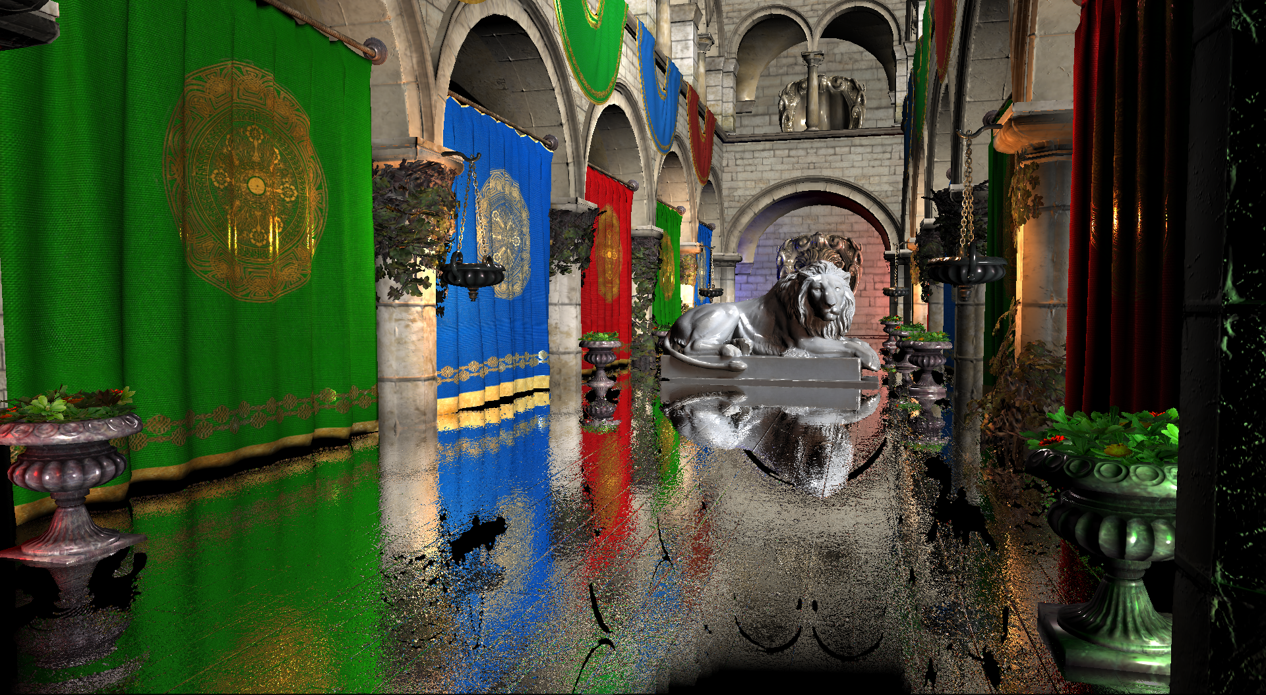
With normal map
Notes:
This is the result with normal map.
As you see, Since the missing data area of ​​Pixel-projected Screen Space Reflection does not change, the black holes created by the projection are not affected by the normal map.

Slide 40
Pixel-projected SSR – Apply roughness
New scaled reflection vectors from importance sampling
(with random seed per pixel)
Notes:
So far, we have only dealt with mirror reflections and could not present scattered reflections along surface roughness.
To improve this, I used a Monte Carlo method to approximate the result using samples with multiple random seed values.
First, generate random seed Xi, which is consists of two values of which ranges are [0, 1], per sample.
(click) Then, do importance sampling (with the seed Xi) according to the lighting model we are currently using to obtain the reflection vector.
If the reflection vectors are valid, as what we did to apply Normal map, (click) scale the reflection vectors and fetch the values from where each reflection vectors indicate and average them.

Slide 41
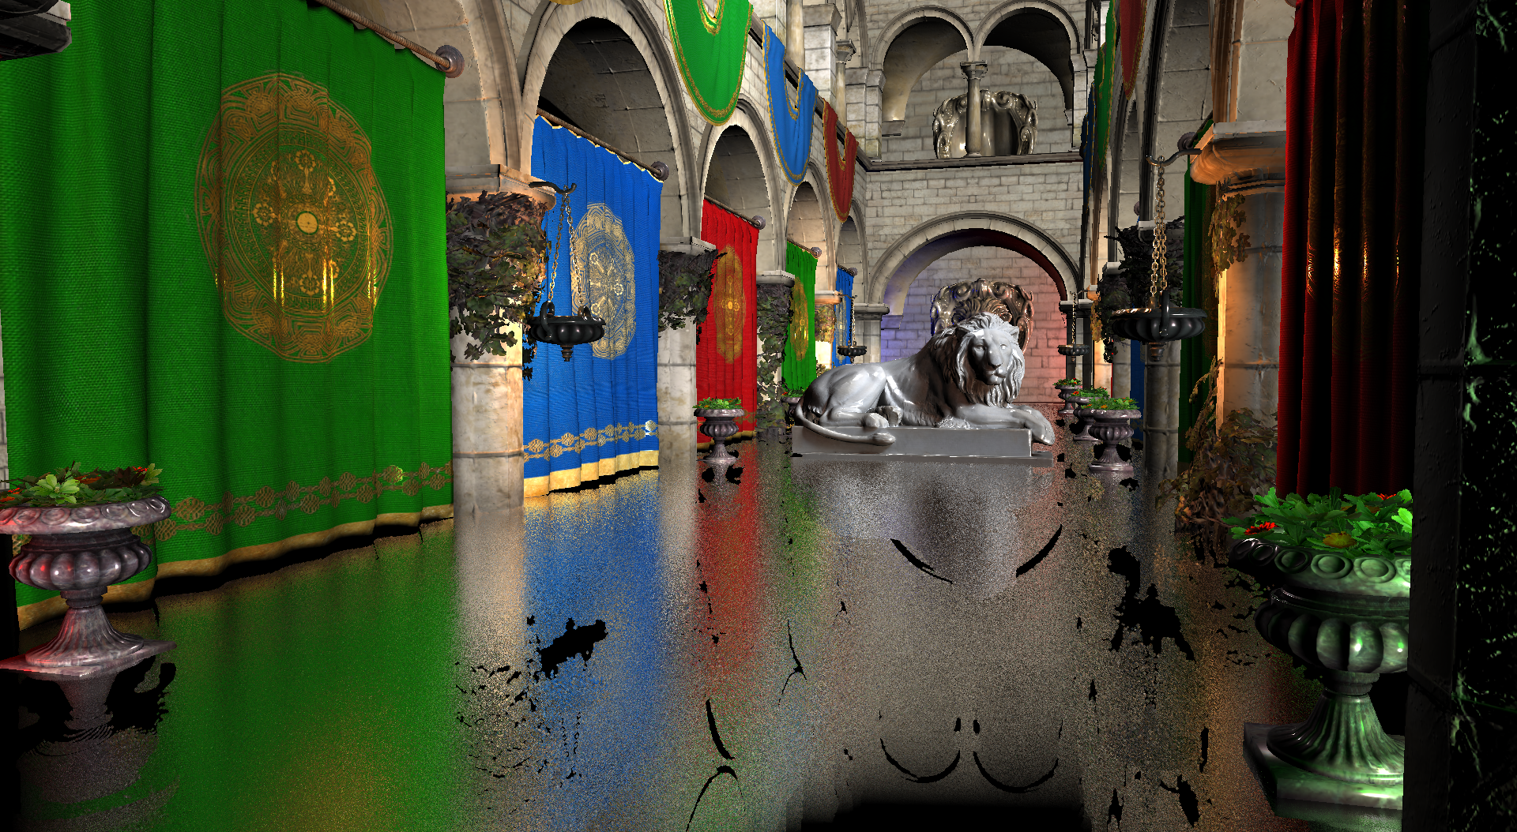
Roughness 0.5
Notes:
So, this is the result with Roughness 0.5.
So far, we have discussed the original idea and how to improve it.

Slide 42
Results
NVIDIA GTX 1060
Core Speed: 1404 MHz
Memory Speed: 2002 MHz
Memory Bus Width: 192 Bit
Intel Core i7-6700HQ Quad Core Processor (2.6 GHz)
Full HD resolution 1920 x 1080
Tested this approach on a complex scene which uses Crytek’s Sponza
and a Lion modeling designed by Geoffrey Marchal
Notes:
Now let's move on to comparing performance and quality.
I implemented this approach with this specification and tested the approach on a complex scene which uses Crytek’s Sponza and a Lion modeling.
Every case is tested in full HD resolution.

Slide 43
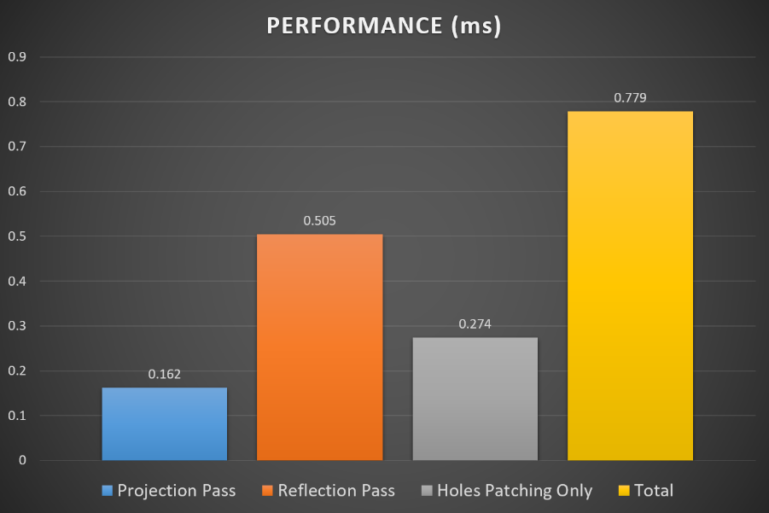
Performance of each stage
Notes:
First is performance of each stage.
As you see, Reflection Pass takes 3times more performance than Projection Pass. And holes patching takes half of whole Reflection Pass’ performance.

Slide 44
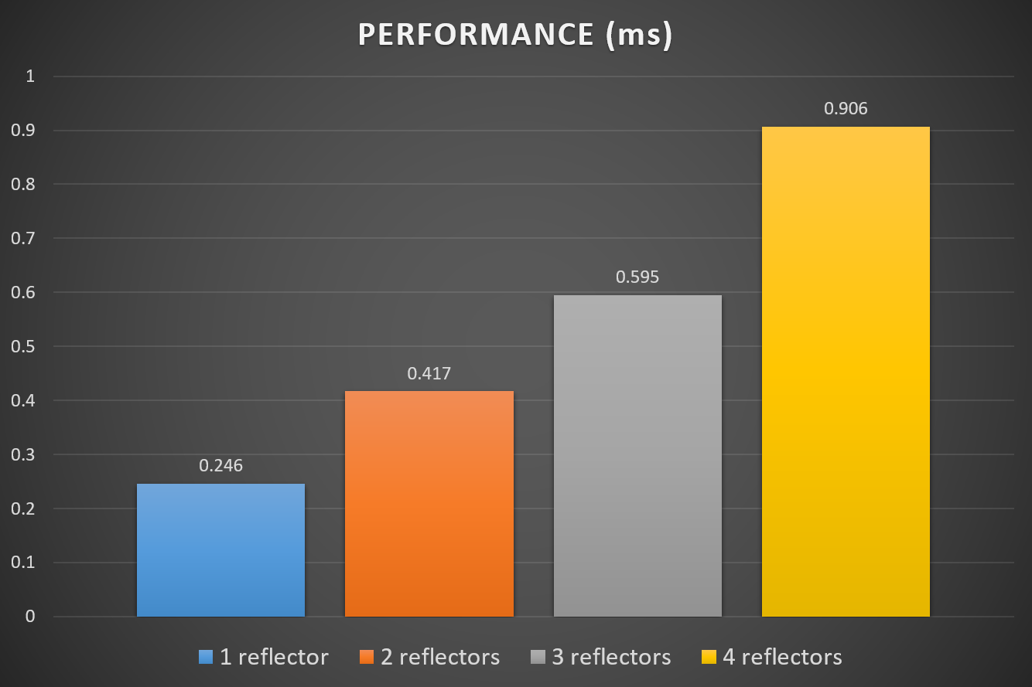
Comparison with different number of reflectors
Using small size of reflectors
Notes:
This is the comparison with different number of reflectors.
Obviously, as the number of reflectors increases, the cost seems to increase.
But in fact, the additional cost of increasing the reflector is not much.
Rather, It is more important the fact how large the reflectors fill the screen than the additional cost for increased number of the reflectors.

Slide 45
Brute force VS Pixel-projected SSR
Notes:
Next is the comparison between Brute force screen space reflections and our approach.

Slide 46
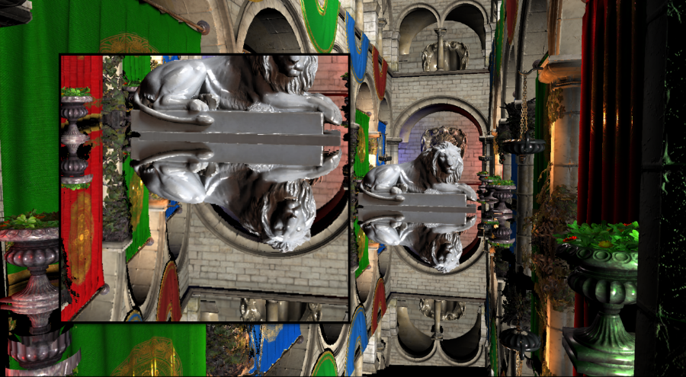
Notes:
Brute force SSR (High quality). Max iteration: 1024. Step size: 0.1. (17.387ms)

Slide 47
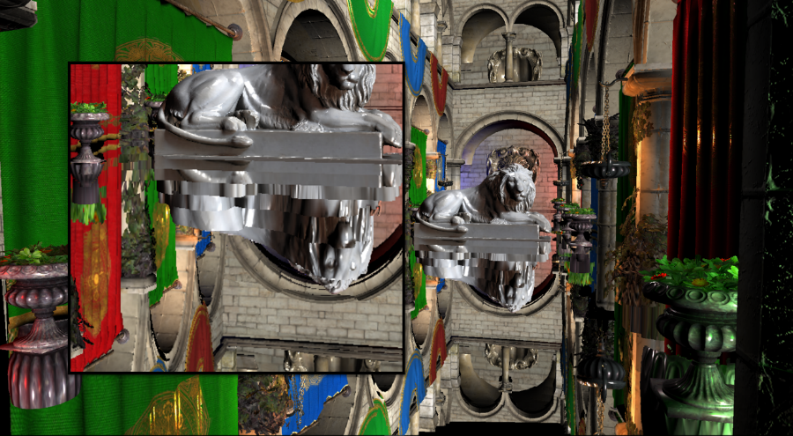
Notes:
Brute force SSR (Low quality). Max iteration: 128. Step size: 5.0. (1.071ms)

Slide 48
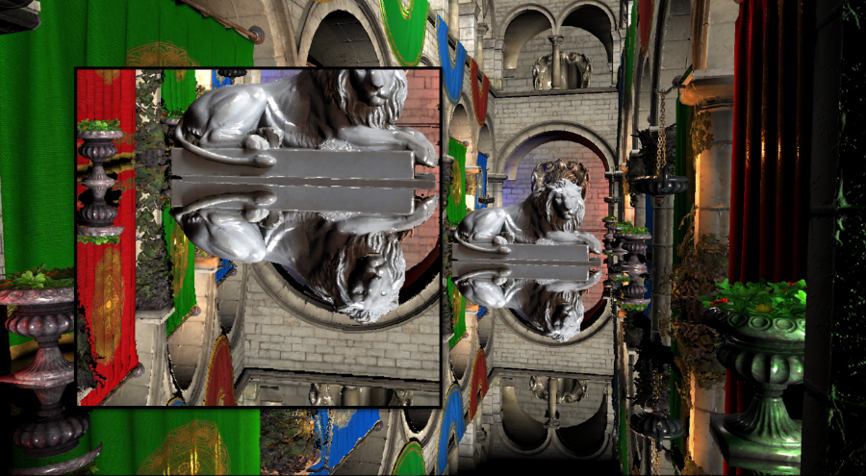
Notes:
Pixel-projected SSR. (0.779ms)

Slide 49
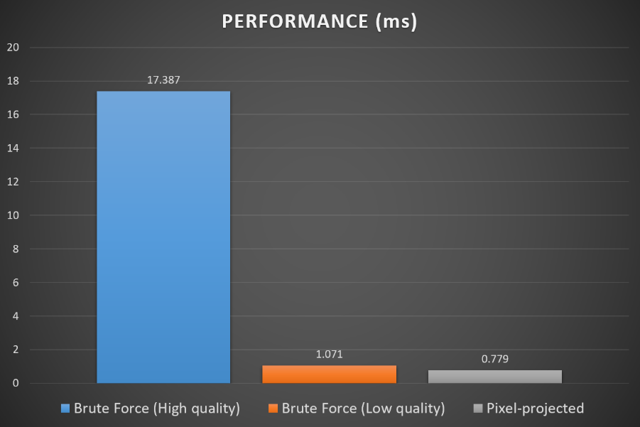
Comparison with Brute Force Screen Space Reflections
Notes:
In terms of performance, pixel-projected reflections is also better than low quality brute force screen space reflections.

Slide 50
Comparison between the results With / Without Normal map
Notes:
Next is the comparison between the results with or without normal map

Slide 51
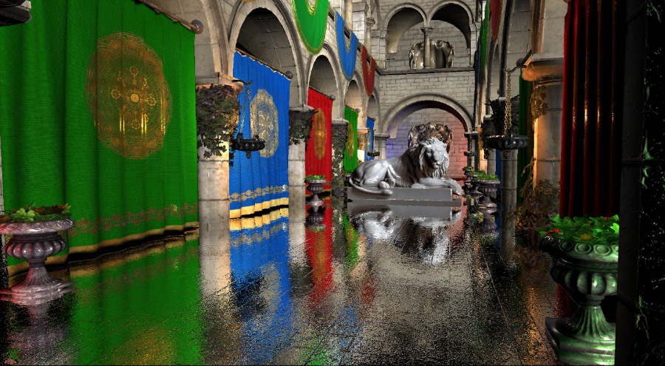
Notes:
Brute force SSR (High quality). Max iteration: 1024. Step size: 0.1. Using depth linear interpolation. Using normal map. (31.071ms)

Slide 52
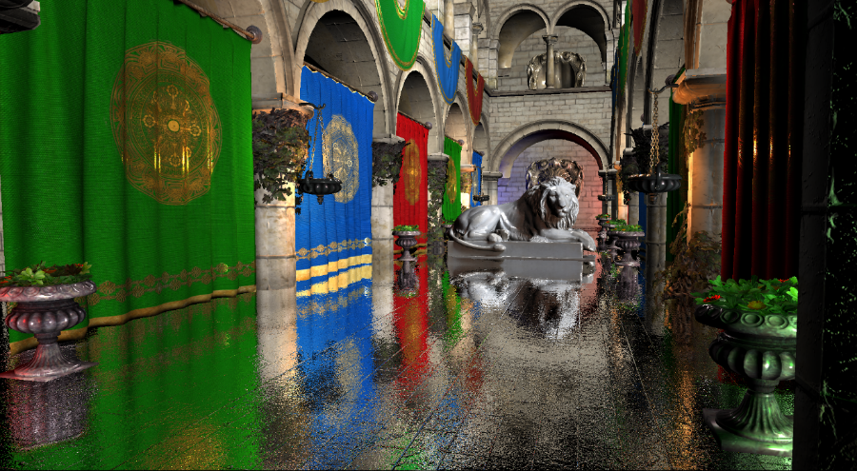
Notes:
Brute force SSR (Low quality). Max iteration: 128. Step size: 5.0. Using depth linear interpolation. (1.941ms)

Slide 53

Notes:
Pixel-projected SSR. Using normal map. (1.306ms)

Slide 54
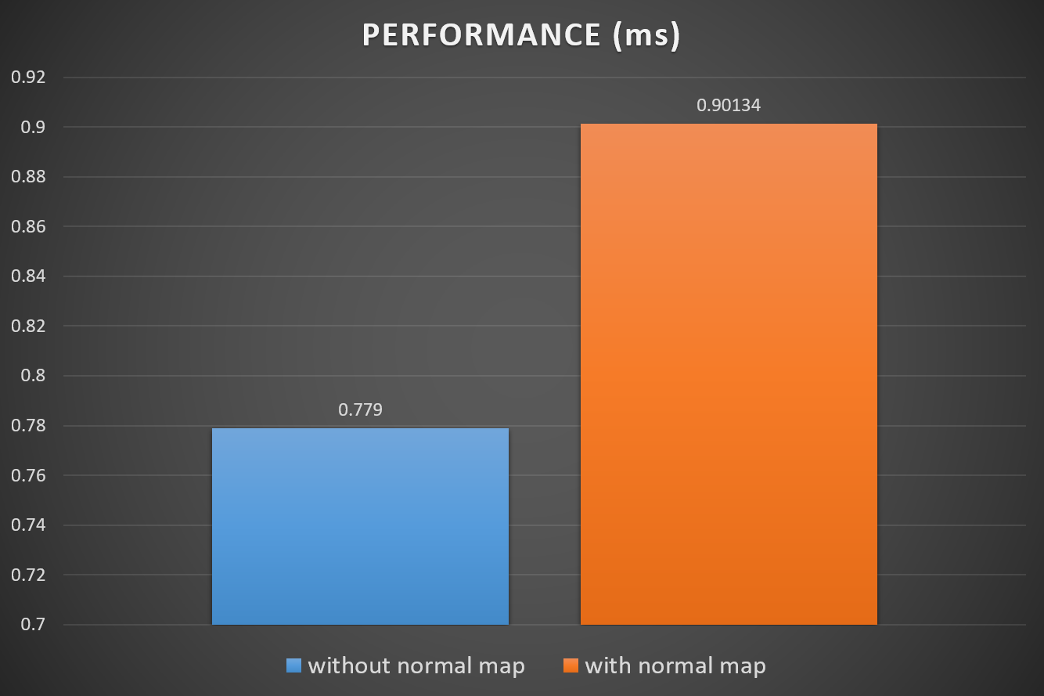
Comparison with and without normal map
Notes:
The most of increased performance is for calculation to convert tangent space normal to reflector’s world space normal and fetch the normal color from normal map.

Slide 55
Comparison between the results with different roughness
Notes:
Next is the comparison between the results with different roughness.

Slide 56

Notes:
Pixel-projected SSR. Roughness: 0.2. GGX Importance sampling. Using 4 samples. (0.802 ms)

Slide 57
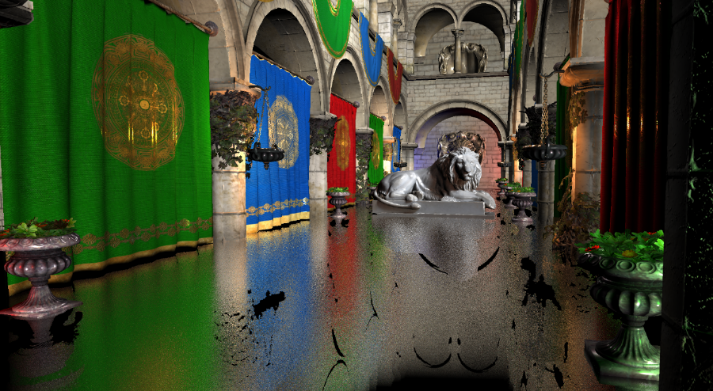
Notes:
Pixel-projected SSR. Roughness: 0.2. GGX Importance sampling. Using 4 samples. (0.802 ms)

Slide 58
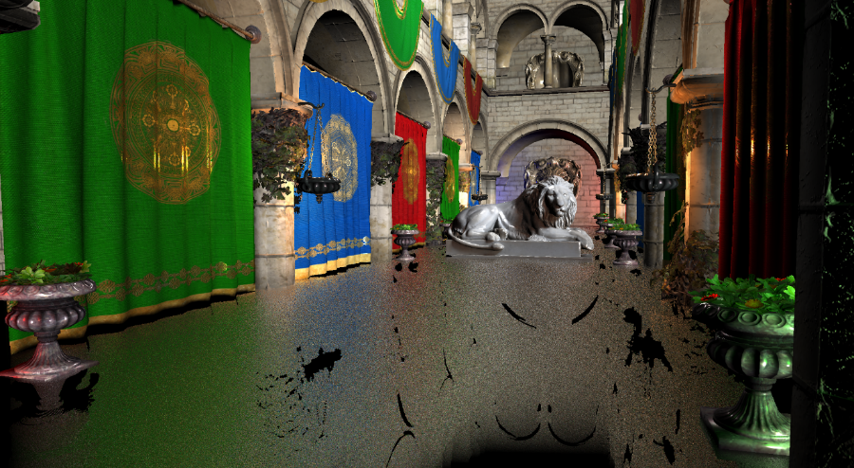
Notes:
Pixel-projected SSR. Roughness: 0.2. GGX Importance sampling. Using 4 samples. (0.802 ms)

Slide 59
Notes:
Pixel-projected SSR. Roughness: 0.2. GGX Importance sampling. Using 4 samples. (0.802 ms)

Slide 60
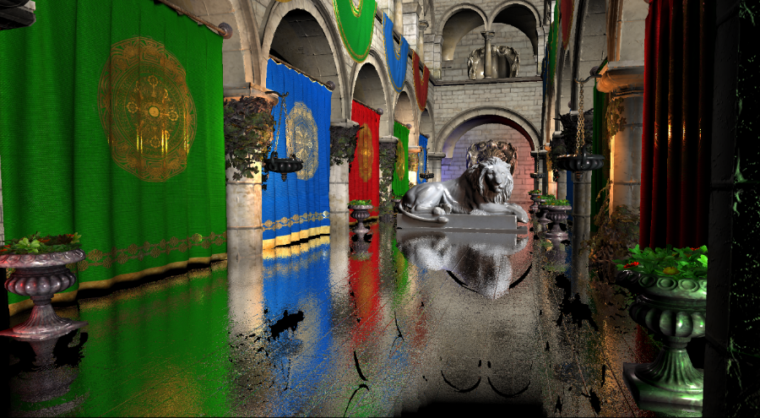
Notes:
Pixel-projected SSR. Roughness: 0.5. GGX Importance sampling. Using 4 samples. (0.802 ms)

Slide 61
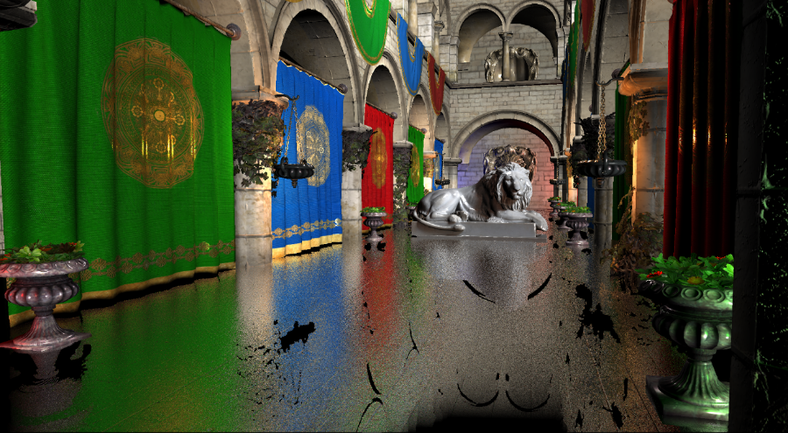
Notes:
Pixel-projected SSR. Roughness: 1.0. GGX Importance sampling. Using 4 samples. (0.802 ms)
As you see, In certain degree of roughness, it looks reasonable.
But, as the roughness increases, the probability of fetching the color information of the irrelevant places also increases, which causes color bleeding artifacts.

Slide 62
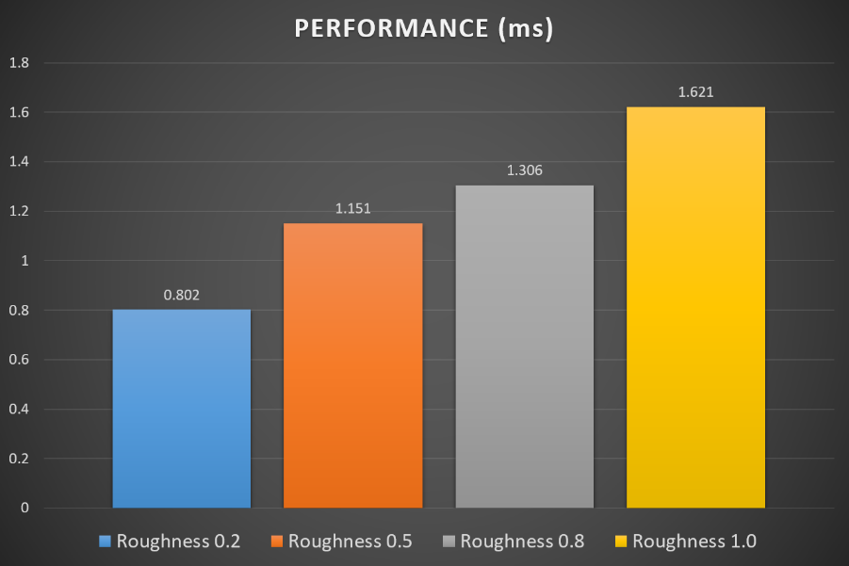
Comparison of the results with various Roughness
Notes:
In terms of performance, it also decreases as the roughness increases.
This is because, as mentioned earlier, the probability of fetching pixels farther away from the current pixel increases, which causes less memory-coherent.

Slide 63
Comparison of the results with different number of Samples
Notes:
Next is the comparison between the results with different number of samples.

Slide 64

Comparison of the results with different number of Samples
Notes:
Pixel-projected SSR. Roughness: 0.5. GGX Importance sampling. Using 1 samples. (1.498 ms)

Slide 65
Comparison of the results with different number of Samples
Notes:
Pixel-projected SSR. Roughness: 0.5. GGX Importance sampling. Using 4 samples. (1.678 ms)

Slide 66

Comparison of the results with different number of Samples
Notes:
Pixel-projected SSR. Roughness: 0.5. GGX Importance sampling. Using 8 samples. (1.764 ms)

Slide 67

Comparison of the results with different number of Samples
Notes:
Pixel-projected SSR. Roughness: 0.5. GGX Importance sampling. Using 16 samples. (2.231 ms)

Slide 68
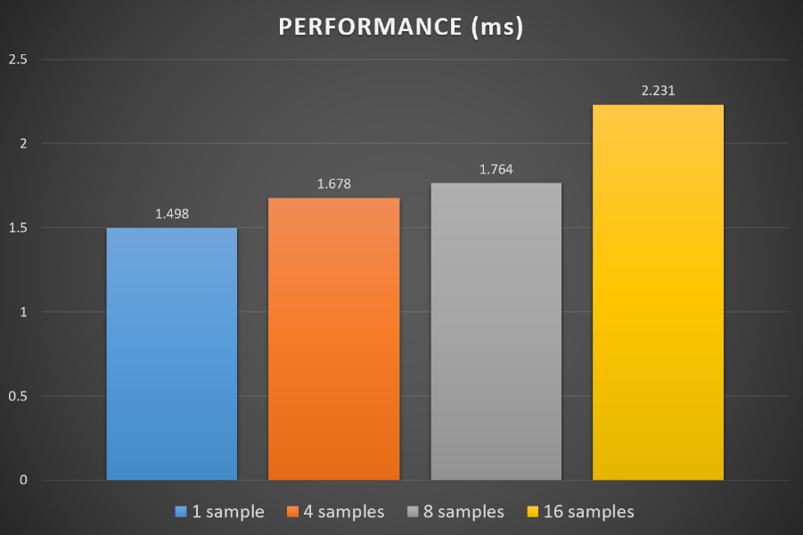
Comparison of the results with different number of Samples
Notes:
As expected, the higher the number of samples makes the lower performance.

Slide 69
Limitations
Missing data
Occluded by other geometries
Out of Screen Space Boundary
Color bleeding artifacts
No glossy reflections
Only simple geometries can be used for reflectors
Notes:
So, here is the limitations of this approach. One of the most representative limitations of screen space reflections is that geometries not drawn on the original scene image cannot be reflected. Our approach has same limitation.

Slide 70
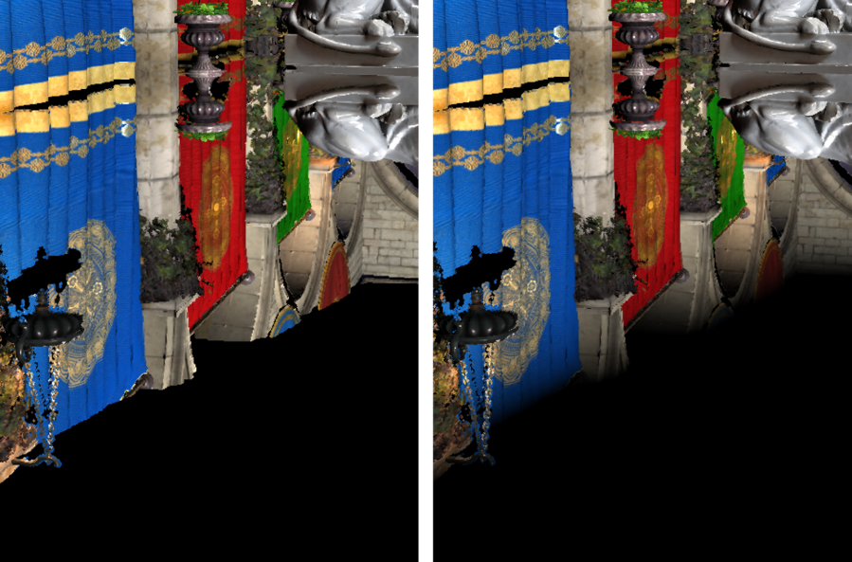
Limitations
Without / with edge fade effect
Notes:
There are two cases which lead this phenomenon. (click) First case is that the geometry itself is in the screen space, but it is not drawn on the original scene image because it is occluded by other geometries. (click) Second case is when the geometry is not in the bound of the original scene image.
In the latter case, the fade effect is applied to minimize the artifact.

Slide 71
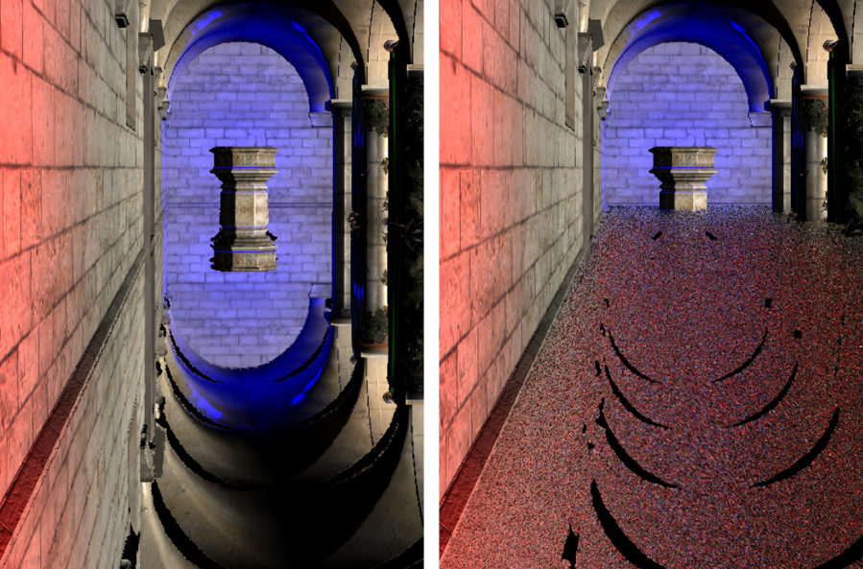
Limitations
Color bleeding
Notes:
And, to account for the roughness of reflectors, this approach relies on approximations to get final colors from the original scene image.
As I mentioned, when the roughness increases, the probability of fetching the color information of the irrelevant places also increases, which causes color bleeding artifacts.

Slide 72
Conclusion
Better quality
More accurate reflection images
Better performance
The fastest approach for performance vs quality
Require reflectors
Limitations to apply normal and roughness
Notes:
Here is the conclusion.
In terms of visual quality, this approach are much better than low quality Brute force which have similar performance. The result is also better than those of the high quality Brute force we tested. So, in the case of mirror reflections, this approach is a superior method in terms of quality and performance.
And, When using a normal map, mirror reflection shows similar results. However, the Brute force method’s missing data area is somewhat blurred by the variation of the direction of the rays from normal map. But, the missing data area of ​​Pixel-projected Screen Space Reflection does not change. So, it makes clear black holes.
And, As the roughness of the reflector increases, the color of reflections also becomes blurred.
And when we use greater the number of importance samples, it is hard to notice any improvement after 8 samples.

Slide 73
Future work
More efficient ray tracing solutions
Complex geometry
Faster acceleration structure
Microsoft’s DirectX Raytracing
Notes:
In the future, if more efficient ray tracing solutions for complex geometry on GPU are devised, this approach could become a much more popular algorithm for screen space reflections. Incidentally, Microsoft presented DirectX Raytracing, a next generation graphics API for ray tracing, in GDC 2018. With this, I expect the using of an efficient GPU ray tracing acceleration structure from DirectX Raytracing will enable ray traversal of complex geometry with much lower cost than before. In other words, Pixel-projected reflections using complex reflectors beyond simple planar reflectors are expected to be possible in real-time in the near future.

Slide 74
References
[Akenine18] Tomas Akenine-Möller, Eric Haines, Naty Hoffman, Angelo Pesce, Michael Iwanicki: Real-Time Rendering, 4th Edition. [Appel68] Arthur Appel: Some techniques for shading machine renderings of solids. AFIPS Conference Proc. 32 pp.37-45 [Bruce07] Bruce Walter, Steve Marschner, Hongsong Li, Ken Torrance: Microfacet Models for Refraction through Rough Surfaces. [Cichocki17] Adam Cichocki: Optimized Pixel-Projected Reflections for Planar Reflectors, SIGGRAPH 2017. [Giacaone16] Michele Giacalone: Screen Space Reflections in The Surge. [Gregory14] Jason Gregory: Game Engine Architecture 2nd Edition. [Lapinski17] Pawel Lapinski: Vulkan Cookbook. [Le17] Trung Le: Evaluating BVH splitting strategies. [Luna16] Frank D. Luna: 3D Game Programming with DirectX 12. [Mansouri16] Jalal El Mansouri: Rendering Rainbow Six Siege, GDC, 2016. [McGuire14] Morgan McGuire, Michael Mara: Efficient GPU Screen-Space Ray racing [Pharr17] Matt Pharr, Wenzel Jakob, Greg Humphreys: Importance Sampling, Physically Based Rendering 3rd edition. pp.794-796. [Raytracing18] “Wikipedia, Ray tracing (graphics)”. URL: < https://en.wikipedia.org/wiki/Ray_tracing_(graphics)> [Stachowiak15] Tomasz Stachowiak, Yasin Uludag: Stochastic Screen-Space, SIGGRAPH 2015. [Uludag14] Yasin Uludag: Hi-Z Screen-Space Cone-Traced Reflections, GPU Pro 5. [Valient13] Michal Valient: Killzone Shadow Fall Demo Postmortem. [Valient14] Michal Valient: Reflections and Volumetrics of Killzone: Shadow Fall, SIGGRAPH, 2014. [Vulkan17] “Vulkan Tutorial”. < https://vulkan-tutorial.com> [Wronski14] Bart Wronski: Assassin’s Creed 4: Road to Next-gen Graphics, GDC, 2014.
Notes:
That’s all. Thank you.

